Slide 1
Sustainable Procurement: Beyond Green Policies to Real Impact
Enabling Sustainable and resilient Supply Chains
Senthil Kumar SUBRAMANI
Procurement Senior Manager
UNOPS, Asia Pacific Region, East Asia Pacific Multi-Country Office

Slide 2
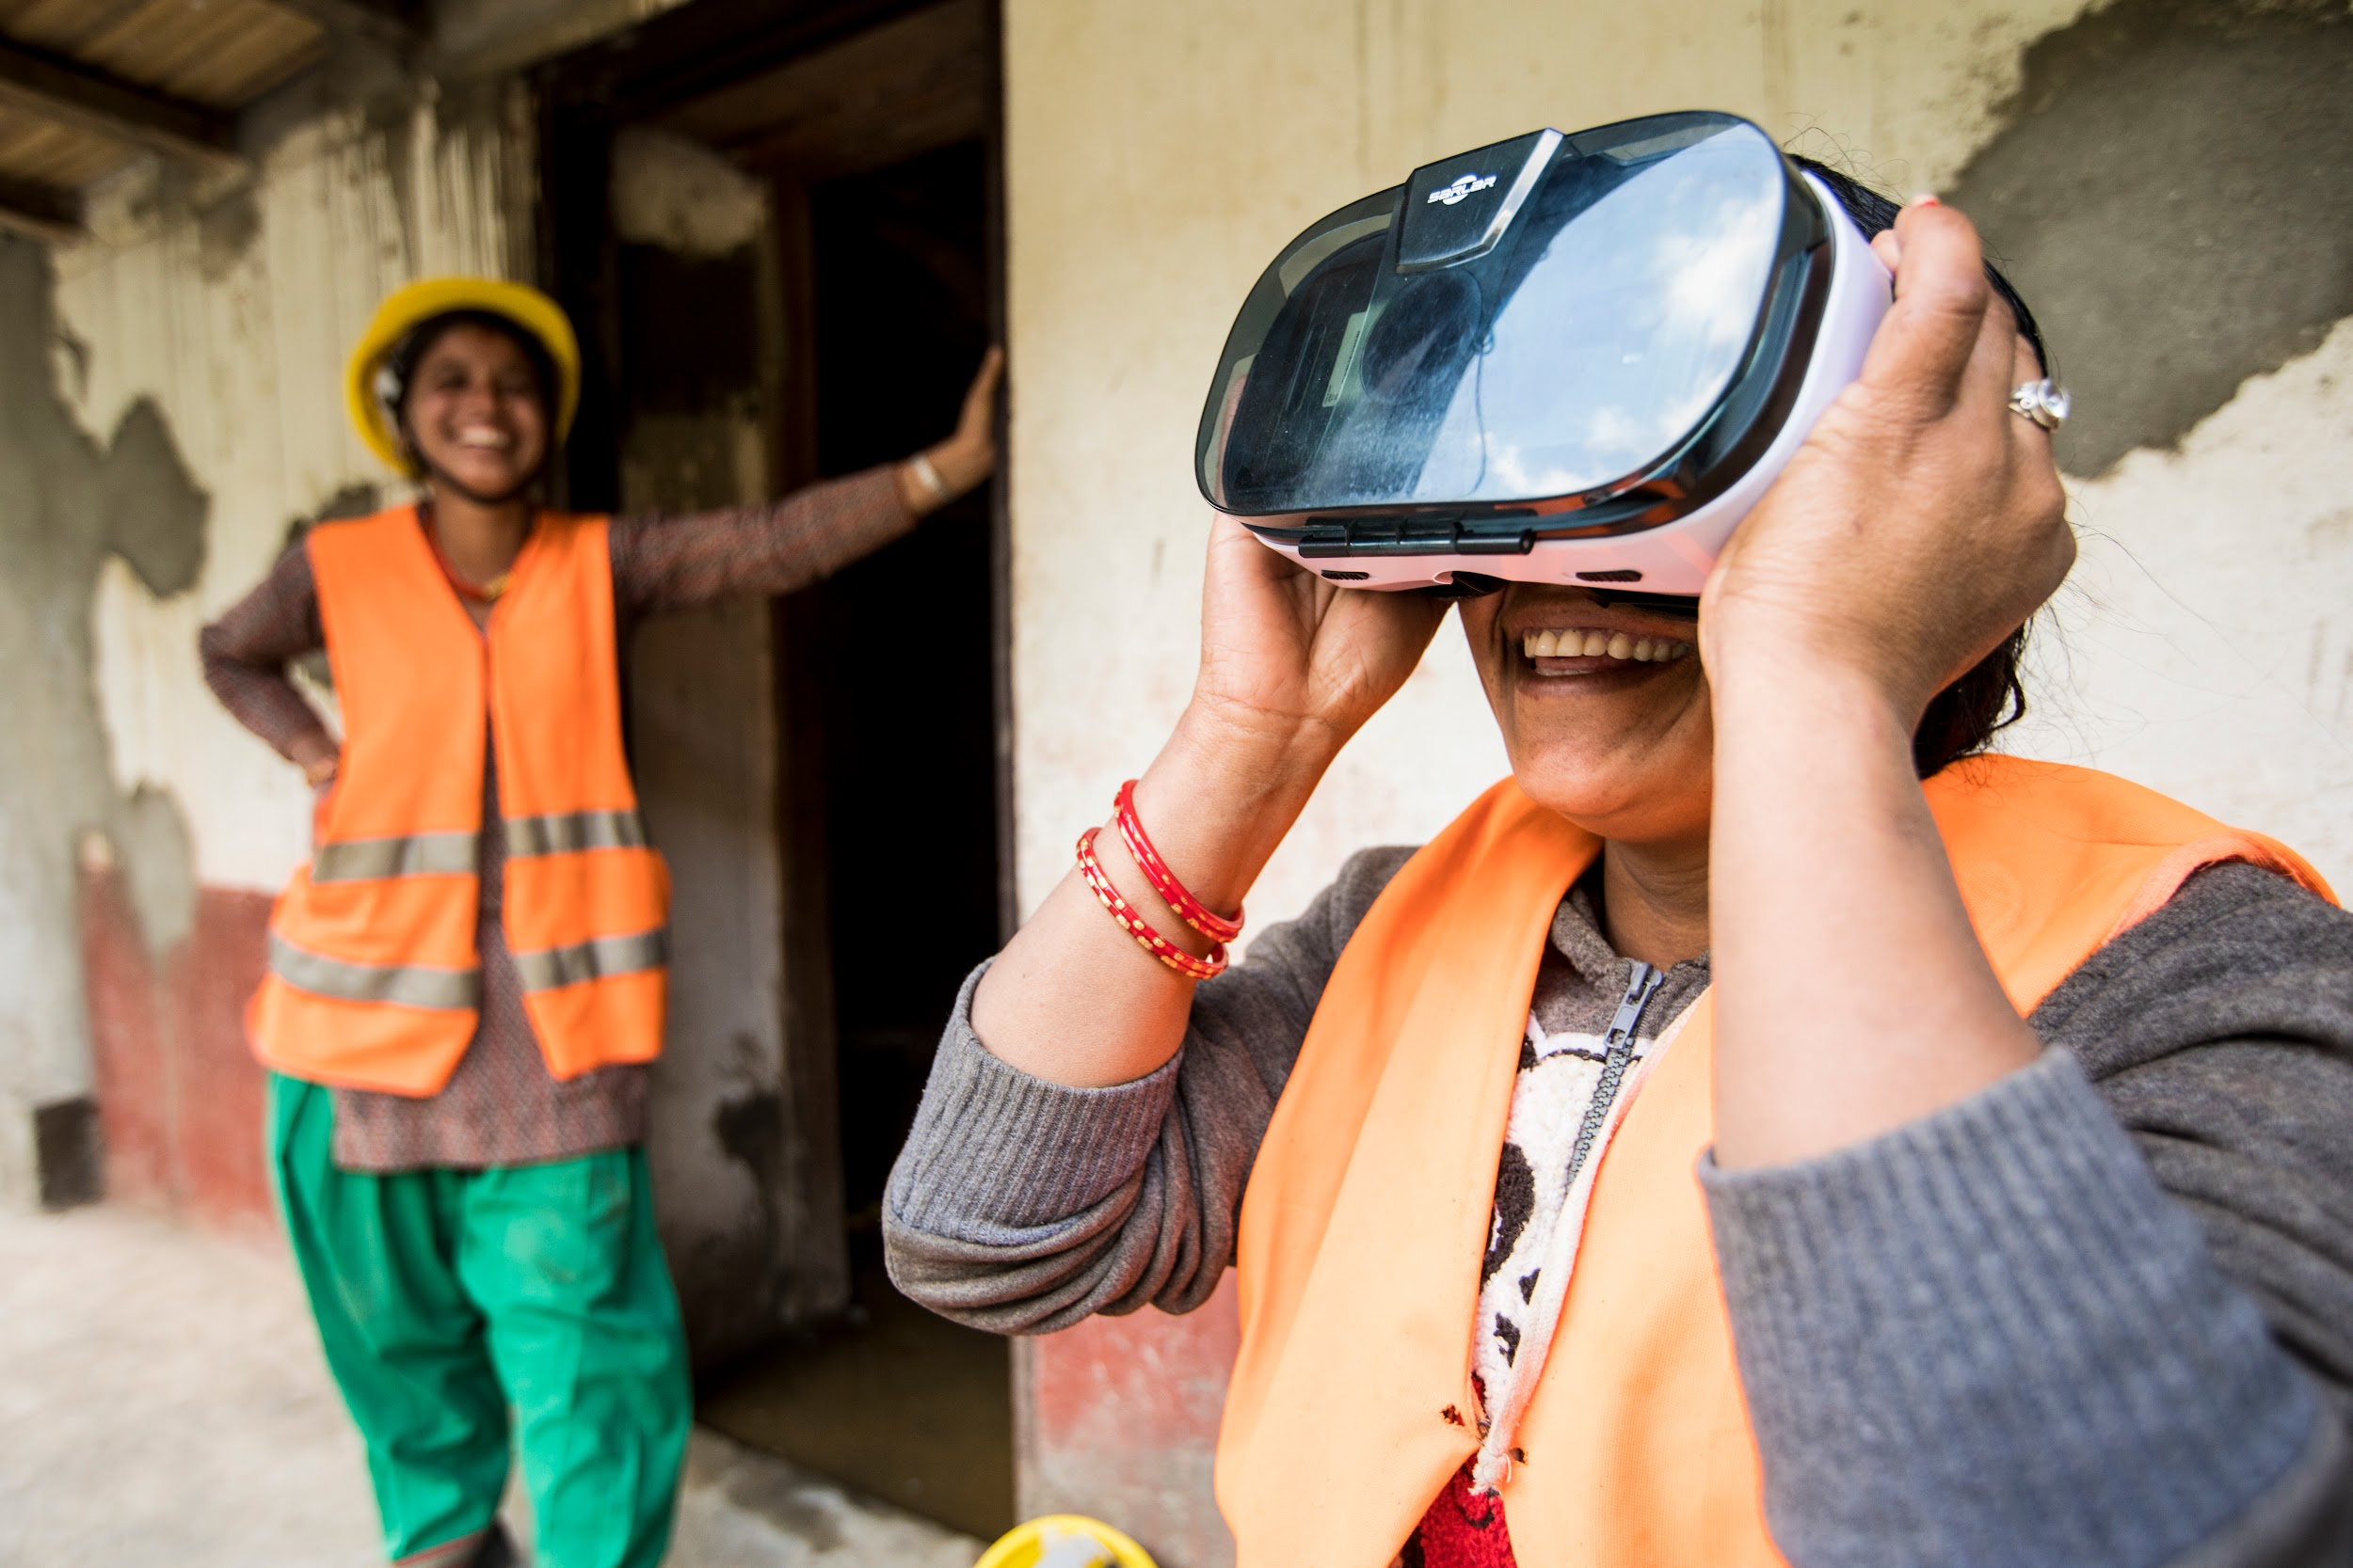
Agenda
What do we do at UNOPS?
Brief history of SP @ UNOPS
SP @ UNOPS in action
Real impact beyond green policies
UNOPS Corporate Programmes
Climate action Programme
DRiVE Programme
Possibilities Programme

Slide 3
What do we do at UNOPS?

Slide 4
What we do at UNOPS?
Our expertise
We expand our partners implementation capacity across five core service lines:
Sustainable & Resilient
Infrastructure
Public Procurement
Project management
Financial management
Human resources
In 2024, UNOPS delivered around $3.0 billion worth of projects through about 1,100 projects in more than 80 countries.
Notes:
UNOPS provides project management, infrastructure and procurement services with a focus on sustainable implementation, efficiency, cost-effectiveness, quality and national capacity development.

Slide 5
2. Brief history of SP @ UNOPS

Slide 6
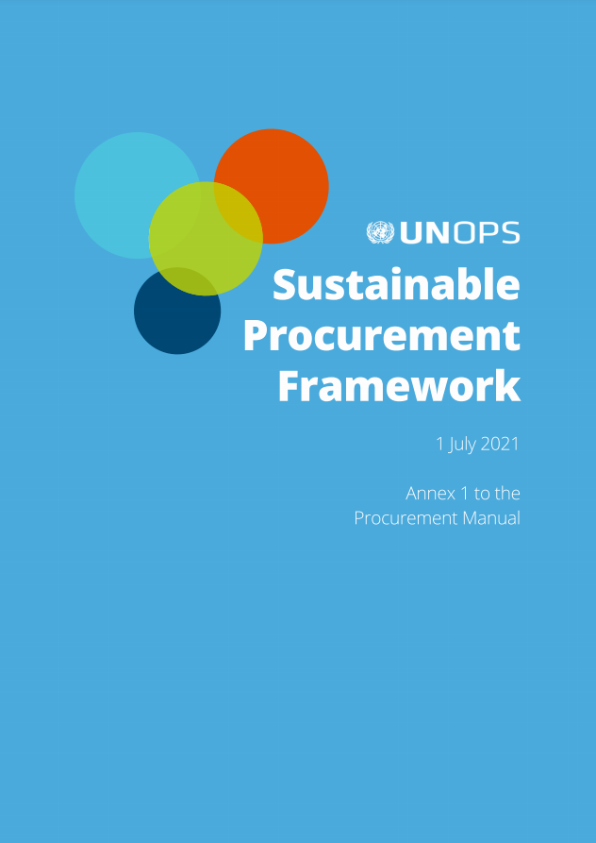
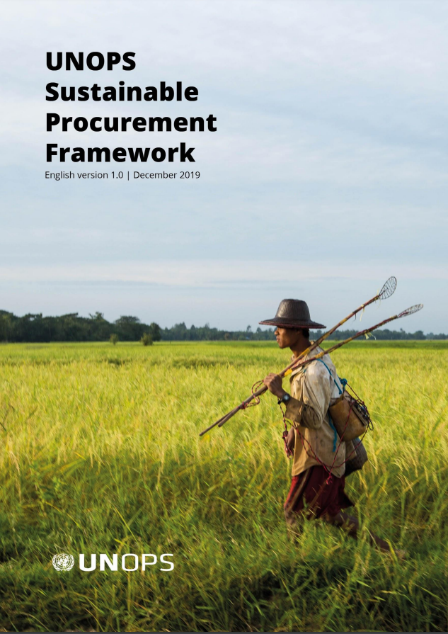
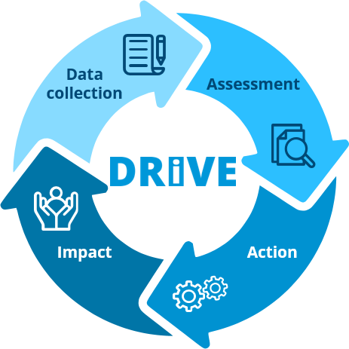
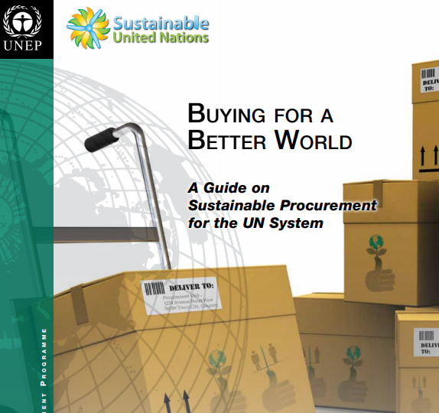
Brief history of SP @ UNOPS
UNOPS journey with Sustainable Procurement over the last 16 years has not only led to procurement transformation - it has established our value proposition as a global leader in providing Sustainable Public Procurement solutions.
SP is transformed into Sustainable Supply Chains
The SP Framework is revised and made publicly available
The first UN SP Framework is Launched
The first UN Supplier Sustainability programme (DRiVE)
The first UN Supplier Diversity programme - UNOPS Possibilities
First UN Guide for SP is developed
SP is included in the Procurement Manual
2008-10
2011-14
2015-17
2018
2019-20
2021-22
2023-

Slide 7
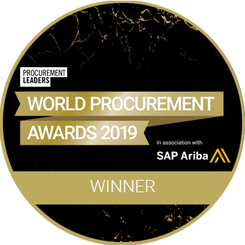
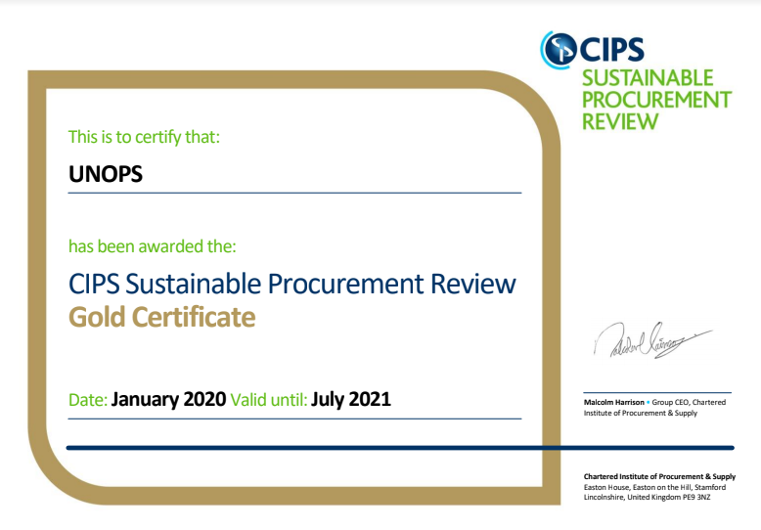
UNOPS Leadership in SP
x5

Slide 8
3. SP @ UNOPS in action

Slide 9
Sustainability in tenders
Sustainability themes covered
SP Guidance and Resource tool is an interactive tool that provides procurement and project teams with tailored guidance and sustainability criteria examples to support decision-making around SP and facilitate effective and comfortable implementation of the requirements of the SP Framework in procurement processes.
Environmental sustainability
Gender equality and social inclusion
Climate change impact
Labour standards
Disability inclusion
Health and safety
Environment, social and governance mgmt systems
Resource efficiency
Key features
SP Criteria List page
Sustainability Criteria Text for tenders
Guidance for verification
Options based on market maturity
Sustainability Contractual Clauses
Mapped to key donor priorities
DRiVE market sustainability analysis
SP in practice
Exemplary tenders and Case studies library

Slide 10
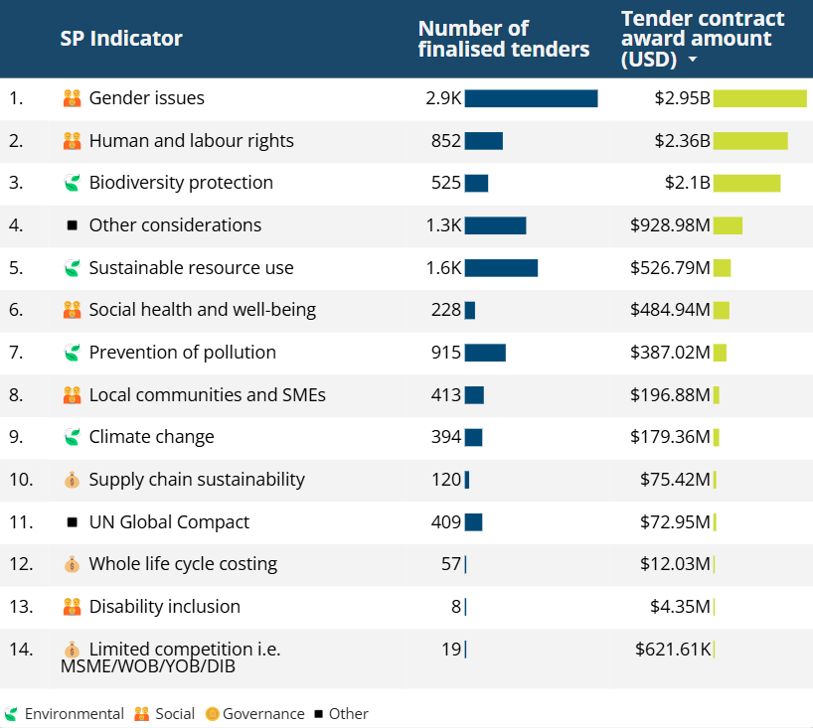
SP - In action - 2020 - 2025
Gender and Social Inclusion criteria are the most widely used SP criteria
Number of finalised tenders with SP criteria
6,300+
Awarded contract amount with SP Criteria
$4.2B
Share of total awarded contract amount
77%
Environmental Criteria
Awarded contract amount
$2.83B
Number of finalised tenders:
2,800+
Social Criteria
Awarded contract amount
$3.77B
Number of finalised tenders:
3,600+
Economic Criteria
Awarded contract amount
$88.07M
Number of finalised tenders:
190+

Slide 11
SP - In action - 2020 - 2025
around
In total, around
$1.7 billion
$3 billion
worth of goods
& services procured for partners
delivered inprojects

Slide 12
4. Real impact beyond Green policies - In action @ UNOPS

Slide 13
4.1 Environmental Sustainability

Slide 14
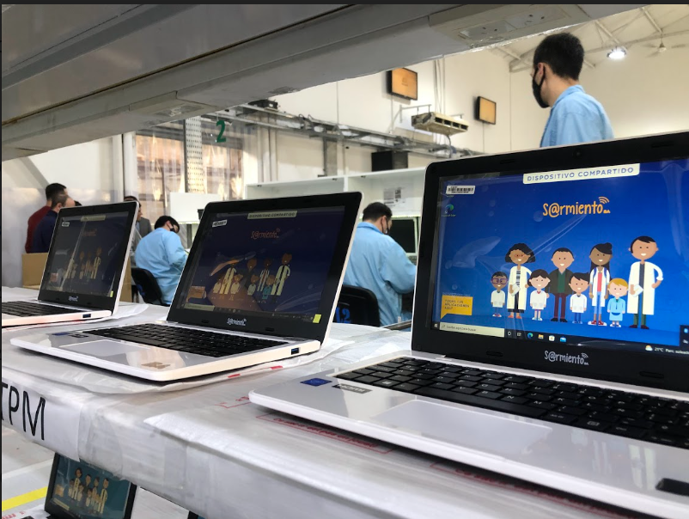
Sustainable Packaging Criteria in Argentina
SDGs addressed in this tender:
Criteria text included in the tender:
Tender Title:
ITB for the supply of 40.000 educational notebooks
Award amount: $10,698,066
Bidders must submit a plan outlining: Packaging reductions ensuring safe delivery of the products
Partner:
Plan Sarmiento, Ministry of Education of City of Buenos Aires
Was this tender successful?
Project Country: Argentina
04 Bids received with SP compliance
The awarded bidder submitted a detailed plan to reduce packaging waste, which included reusing original packaging, bulk packing netbooks, and utilizing locally produced packaging.
8,000 kg of packaging waste and associated transport emissions.
The unit cost for the netbooks was 3 USD less than the price from the previous year, leading to a total savings of 120,000 USD.
What were the lessons learned?
Incorporating sustainability criteria in procurement processes offer opportunities for improvement and increased benefits without necessarily incurring higher costs or risks.
Sustainable Supply Chains

Slide 15
4.2 Gender Equality and Social Inclusion

Slide 16
WOB Initiative in Yemen
Project:
2021, Yemen Integrated Urban Services Emergency Project (YIUSEP)
Women’s economic empowerment
USD 01 million targeted procurement towards WOBs
Full 100% women ownership
Valid commercial registration with commercial activities of SMEs
Valid Tax identification
Donor: World Bank
Results
US$ 1 million worth goods and services delivered by WOBs in Yemen
10 Tenders reserved for WOBs
19 Lots in total
Lessons learned:
Asses outcomes from completed contracts and carry out corrective actions
Transiting WOBs to participate in general tenders
Reach out campaign to identify WOBs in different cities within the country

Slide 17
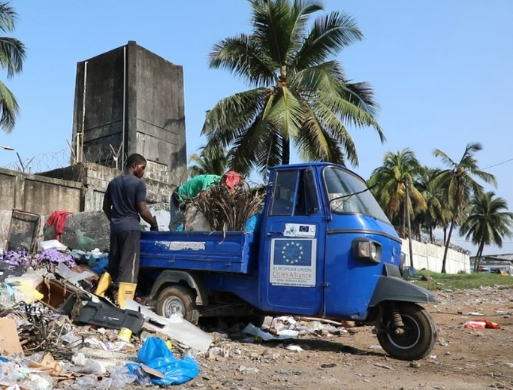
Gender mainstreaming in Liberia
SDGs addressed in this tender:
Criteria text included in the tender:
Tender title:
Consultancy Services to Develop a Legal framework and policy to Operate Microfinance Loan Facility for Community Based Enterprises (CBEs) in Liberia
Bidders should provide a plan that outlines: what percentage of opportunities will be reserved (as defined by the % of total headcount at all levels)? Cities Alliance program gender action plan which required the inclusion of gender criteria in all tenders.
Was this tender successful?
04 submitted bids
Award to women-owned business.
This local women-owned business with over 50% female employees in its workforce
Project country:
Libera
Partner:
EC European Commission (other)
What were the lessons learned?
Award amount:
$65,375
Market research and experience sharing are key.
Knowledge sharing between colleagues
Sustainable Supply Chains

Slide 18
4.3 Climate Change Impact

Slide 19
UNOPS laptops procurement in 2024
In 2024, UNOPS procured laptops for internal corporate use of which
94% were TCO certified, and
98% had EPEAT Gold label.
Procurement of laptops for projects implemented on behalf of the donors
38% (4.7M USD) of procured laptops were TCO certified, and
40% (4.9M USD) of laptops had EPEAT label.
Notes:
Global electronics sustainability label
Developed by the Green Electronics Council (GEC)
Awarded to products that meet environmental performance criteria
Criteria address the full product lifecycle, from design to disposal
Three tiers of environmental performance: Bronze, Silver and Gold
Products are evaluated against 51 environmental criteria
23 required and 28 optional

Slide 20
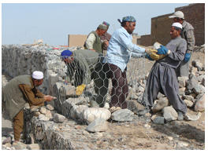
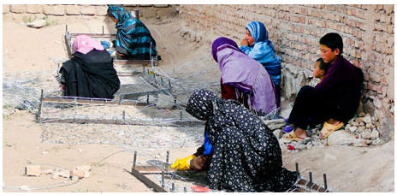
Case Study: re-thinking procurement of works in UNOPS Afghanistan
Challenge
Frequent flooding of the village of Jabraeel, Afghanistan
Solution
Construction of a retaining wall to limit flooding
Sustainability
Women were trained to build gabion baskets (cages weaved from wire) to hold the stones, and men filled the baskets with stones.
Full community participation
Gender mainstreaming
Training in marketable skills

Slide 21
4.4 Disability Inclusion

Slide 22
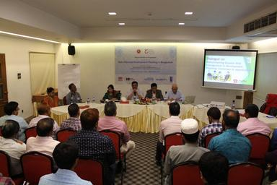
Inclusion of Disability Criteria in Tenders in Bangladesh
SDGs addressed in this tender:
Criteria text included in the tender:
The bidder shall ensure that venues/Infrastructure is designed to be accessible for persons living with disabilities (for example ramps, railings, handrails, lifts, larger restrooms and appropriate fixtures, a venue at ground level, visible signage, and assistive technology)
Tender title:
Venue, Meal and Accommodation Services for NRP project National Resilience Programme (NRP)
Award amount: $49,614.29
Partner:
SIDA Swedish International Development Cooperation Agency
Was this tender successful?
Project country: Bangladesh
05 bidders submitted their quotations
03 bidders complied with this sustainability criterion.
What were the lessons learned?
This criterion should be accurately specified to ensure that the awarded supplier will provide all the requested items and not partial requirements.
Sustainable Supply Chains

Slide 23
4.5 Health and Safety

Slide 24
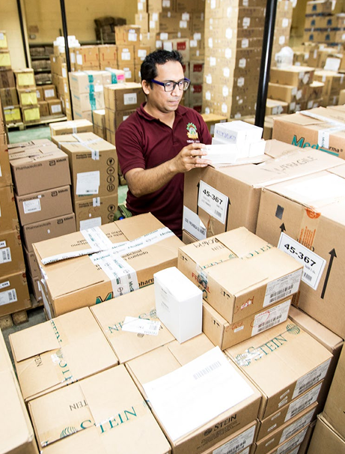
Guatemala: Fighting corruption through Health Procurement
2015, Corruption cases reported in Guatemala’s Social Security Institute (GISS)
UNOPS improved transparency in procurement by strengthening capacities and transparency in pricing
US$400 million procured from 2016 - 2022 - medicals supplies
Read More
Here
“Purchase for Impact 2023”

Slide 25
4.6 Environment, resource efficiency

Slide 26
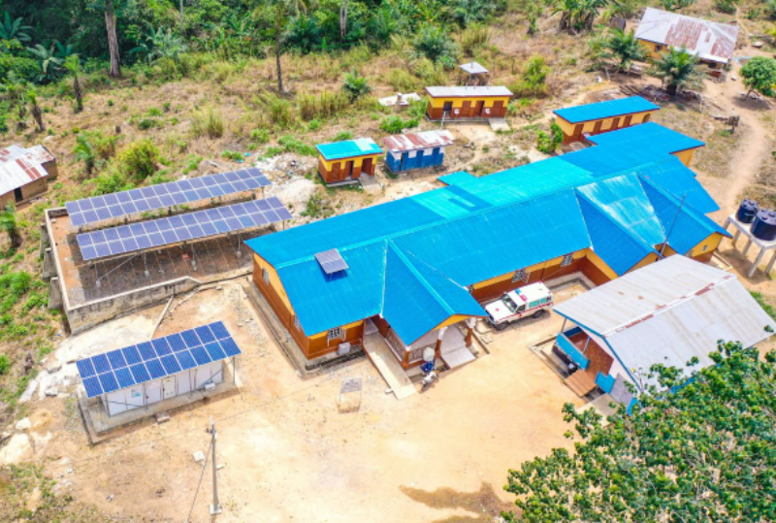
Rural Renewable Energy Project (RREP) in Sierra Leone
SDGs addressed in this project:
PROJECT-WIDE SUSTAINABILITY
The project especially focused on local capacity building and community involvement and inclusive distribution of project benefits. Local capacity to maintain the mini-grids past project completion is key to sustained function and project benefits.
Capacity building:
Training local technicians for continued mini-grid community care & maintenance.
Local employment:
50 local engineers hired for assembly and installation.
Gender inclusion: 30% of hired engineers were women.
Environmental and Social Minimum Requirements:
Required EMS certificate and compliance with labour and human rights from suppliers.
Project Title:
Rural Renewable Energy Project
Project Country:
Sierra Leone
Project Budget:
$49 million
Project Donor:
United Kingdom Foreign, Commonwealth and Development Office (FCDO)
Project Timeframe:
2016 - 2022
DRiVE Supplier Sustainability Self-assessment:
41 suppliers from 17 countries in competition for 6 tenders
3 suppliers for 2 tenders for questions under management systems (quality, environment, and health & safety). Verified suppliers advanced maturity
Sustainable Supply Chains

Slide 27
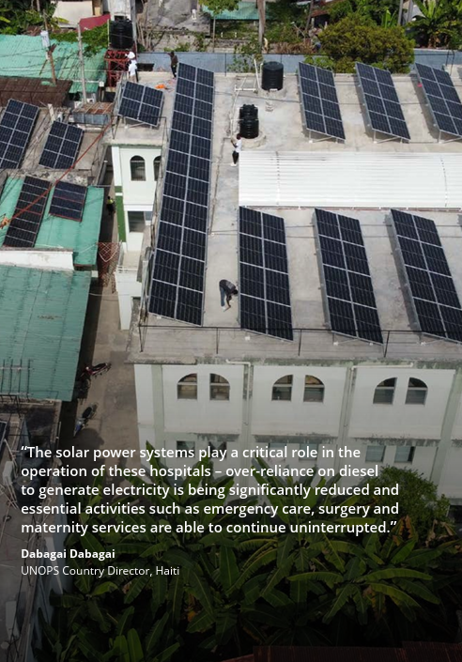
Haiti: Powering hospitals with solar energy
UNOPS to provide Hybrid solar power systems for 05 hospitals
500,000 Haitian people benefited from reliable source of energy
World Bank: US$3.5 million
Local communities - employment
Solar Systems for hospitals (health related SDG)
Solar powered water pumps providing safe drinking water
Read More
Here
“Purchase for Impact 2023”
Read More
Here
“Purchase for Impact 2023”

Slide 28
5. UNOPS Corporate Programmes - Sustainability

Slide 29
5.1 UNOPS Climate commitment
Climate Action Programme

Slide 30
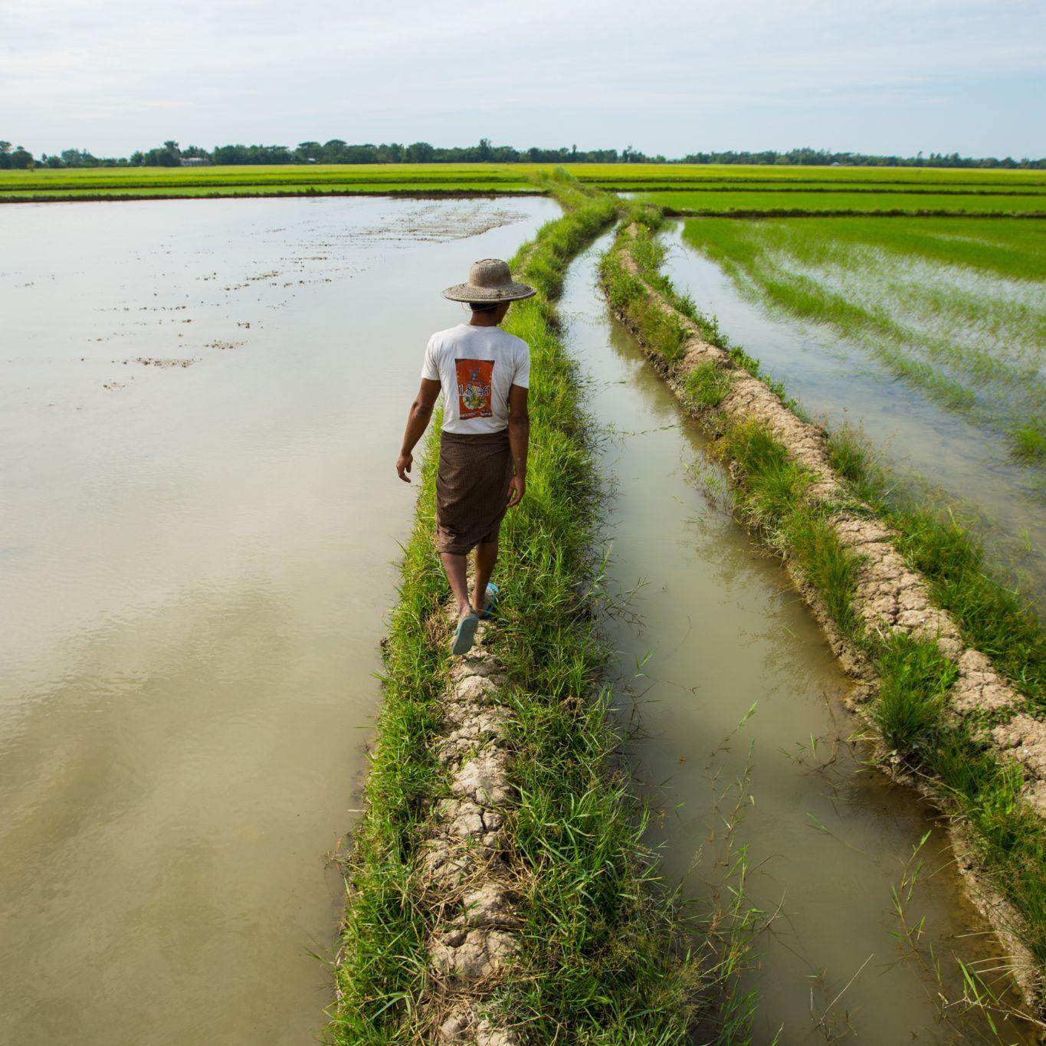
UNOPS Climate commitment at COP28
Climate Action Programme
45%
Reduce absolute emissions by 45% from our operations by 2030
Net-zero
Reach net-zero before 2050
Scope 3
Account for emissions in our value chains
Climate Resilience
Integrating climate-resilient practices in our project

Slide 31
5.2 DRiVE - Delivering Responsibility in Vendor Engagement

Slide 32
What is ?
Delivering Responsibility in Vendor Engagement
Enhanced risk management
Improved customer relations
Capacity building for suppliers
Supply chains transparency
Data-Driven approach
Leverage for sustainability
Notes:
UNOPS has developed our supplier sustainability programme, DRiVE, to assess and build the capacity of suppliers on sustainability.
Through the programme we are able to
Understand how suppliers manage sustainability in their organisations
Identify potential sustainability risks in the supply chain
Identify areas for improvement
Partner with suppliers through the development of Corrective Action and Preventive Action (CAPA) plans
DRiVE Process:
DATA COLLECTION: Data is collected from suppliers during the tender process through the DRiVE Supplier Sustainability questionnaire.
ASSESSMENT: The data is assessed through verifications and site visits to ensure that the data is accurate.
ACTION: A corrective action plan (CAPA) is issued to suppliers, based on the feedback from the reviewed questions. It is completely voluntary for the suppliers to participate.

Slide 33
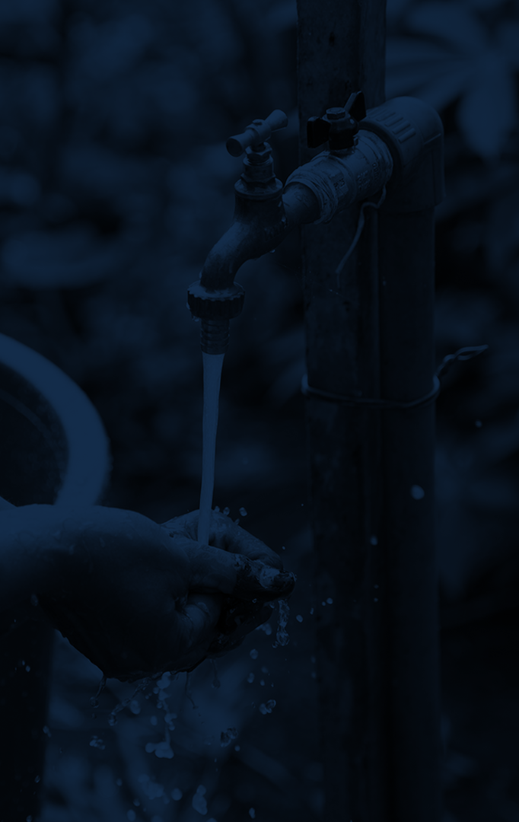
DRiVE
DRiVE is the UNOPS Supplier Sustainability programme.
It focuses on understanding how our suppliers manage sustainability issues and risks within their organisations. Our goal is to help them build and promote more sustainable and responsible business practices.
Environmental management
Equal Opportunity
Climate change impact
Human rights
Supply chain management
Labour standards
Health and safety management
Organization, System and Policies
Quality management
Ethical conduct
Notes:
DRiVE Programme focus on these 10 sustainability areas Environmental management
Equal Opportunity
Climate change impact
Human rights
Supply chain management
Labour standards
Health and safety management
Organization, System and Policies
Quality management
Ethical conduct

Slide 34
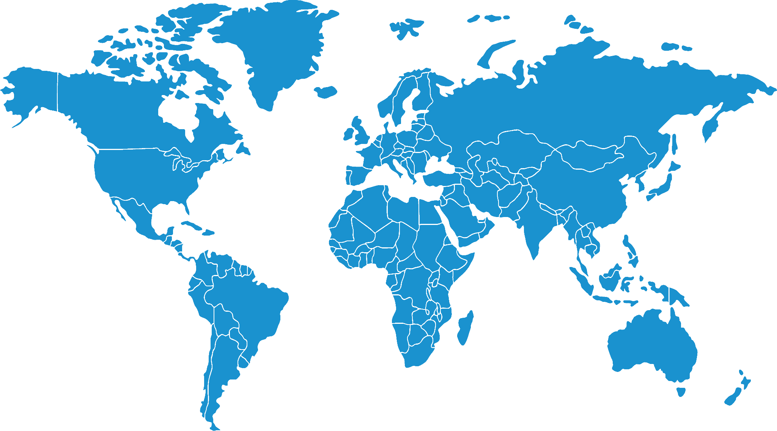
DRiVE inspections across the world
United Kingdom Suppliers verification in
Peace and Security Cluster
Denmark Site inspections of UNWebBuy+ LTA holders
Austria Site inspections and capacity building
China Site inspections and capacity building
Mexico Site inspections and capacity building of medicines and medical devices suppliers
Lebanon Site inspections and capacity building
Honduras Engagement of health suppliers in GD&I
Jordan Supplier verification and capacity building in
PSEA
Nicaragua Engagement of suppliers in GD&I and Human Rights
Kenya Verification of suppliers as part of the DRiVE Risk App Pilot
Argentina Site inspections and climate engagement with ICT equipment suppliers
Sierra Leone Site inspections and capacity building

Slide 35
5.3 Possibilities - Supplier Development and Diversity

Slide 36
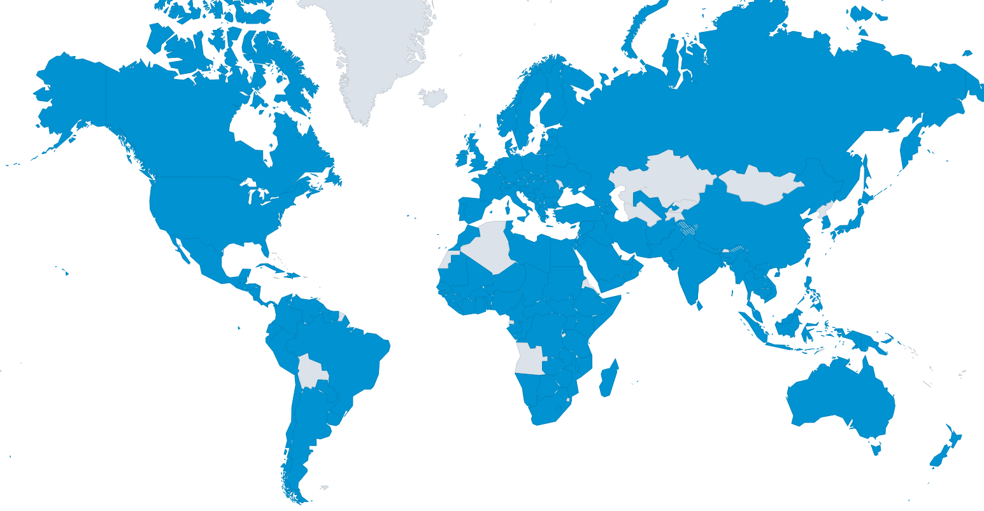
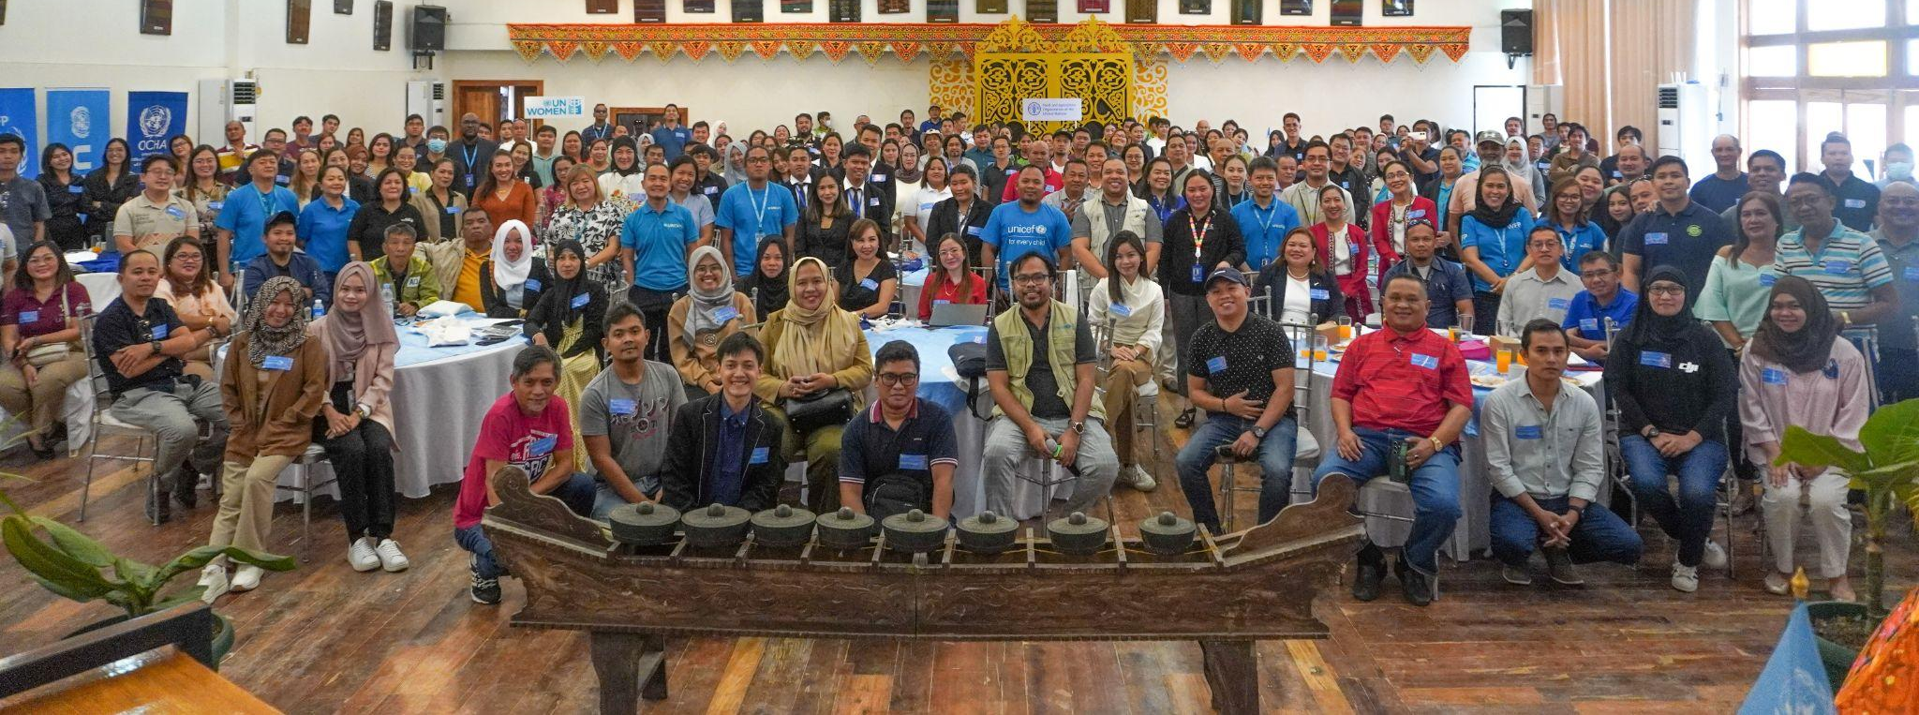
UNOPS Possibilities Forums 2016-2024
42
OF THOSE SUPPLIERS,
WERE NEW TO UNOPS
23
UP FORUMS
2,140+
PARTICIPANTS
1,160+
UNGM REGISTERED SUPPLIERS
$210.22M
PROCURED FROM DIVERSE PARTICIPATING SUPPLIERS
230+
PARTICIPATING SUPPLIERS AWARDED
Jordan
50+ participants
10 UNGM supplier registrations
Sierra Leone 160+ participants
50+ UNGM supplier registrations
Philippines 160+ participants
75 UNGM supplier registrations
Paraguay 240 participants
110+ UNGM supplier registrations
Myanmar 130+ participants
95 UNGM supplier registrations
DR Congo 159 participants
110+ UNGM supplier registrations
Mozambique 157 participants
60+ UNGM supplier registrations

Slide 37
Supplier Testimonial - Philippines

Slide 38
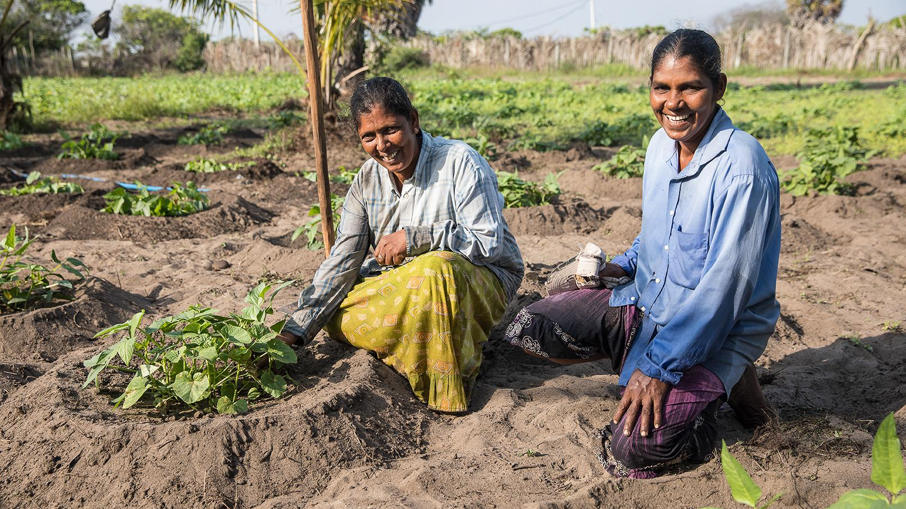
Sustainable
Supply Chains
Please feel free to ask
your questions:
sustainable.procurement@unops.org
Discover our report “Purchase for impact 2023”

