Slide 1
AI Sandbox: Experimenting with the Future of Public Procurement
When machines handle the process, humans can focus on the purpose.

Slide 2
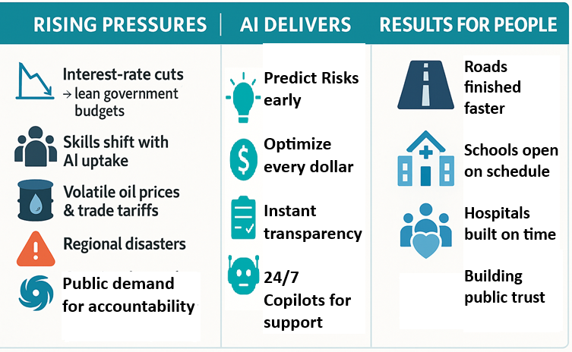
AI: The Must‑Have Tool in Turbulent Times

Slide 3
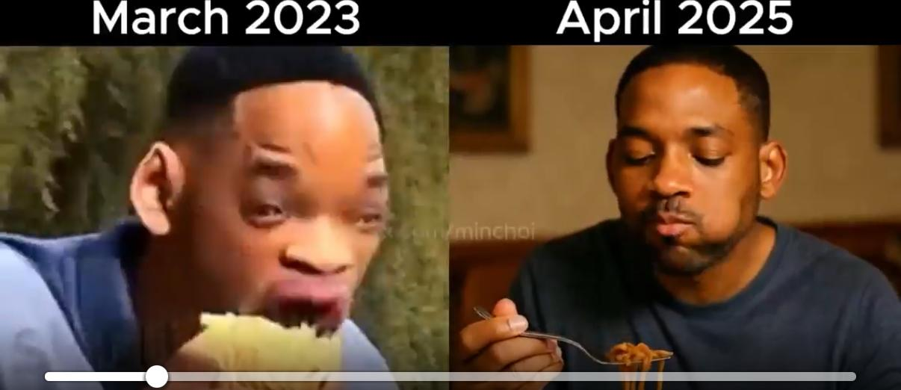
How AI has improved

Slide 4
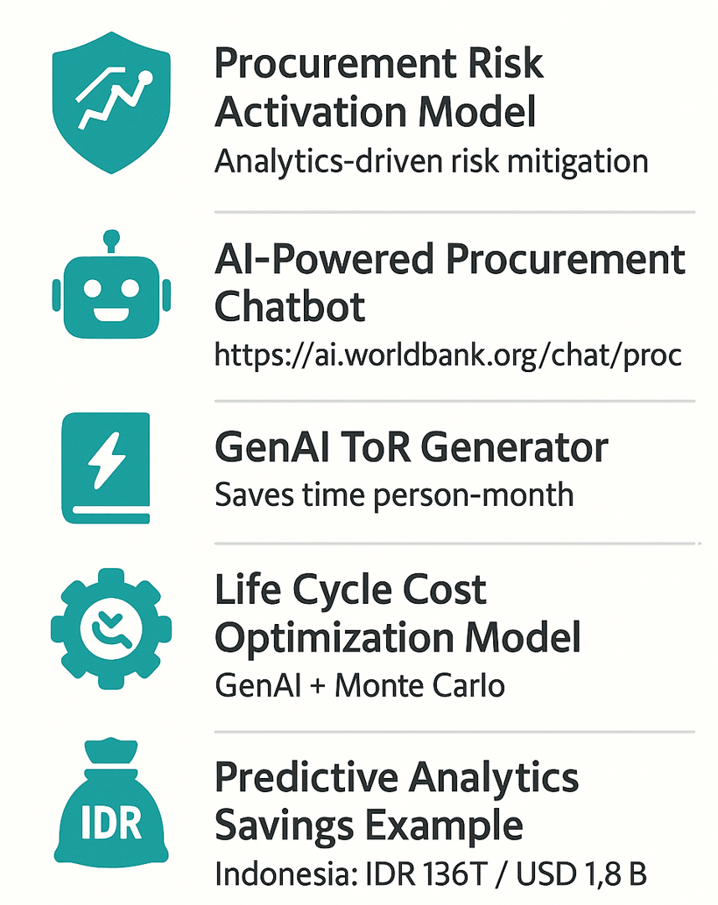
AI reshaping Procurement - Today

Slide 5
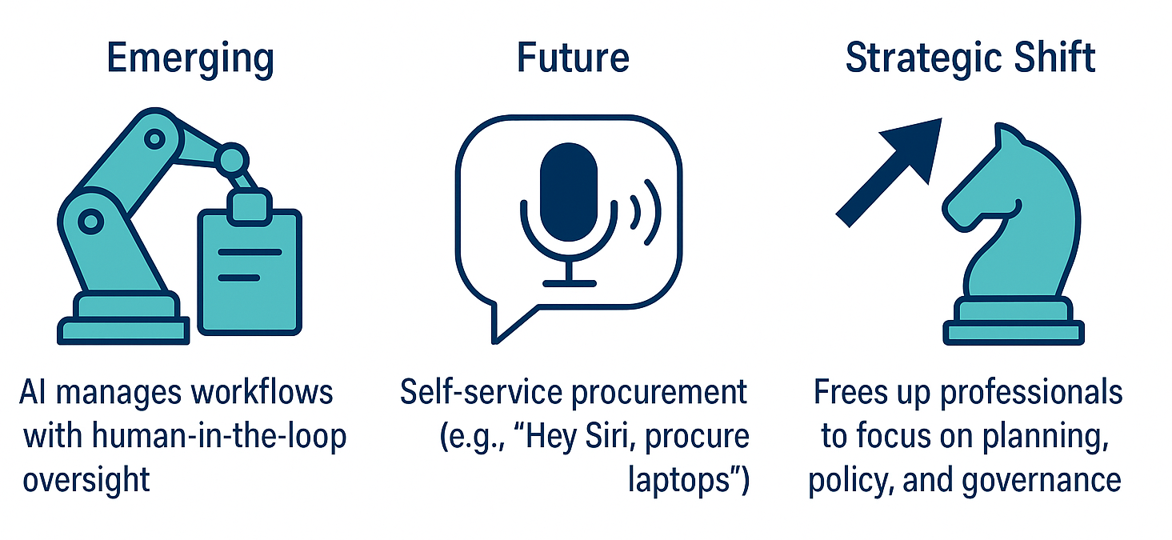
AI reshaping Procurement - Tomorrow

Slide 6
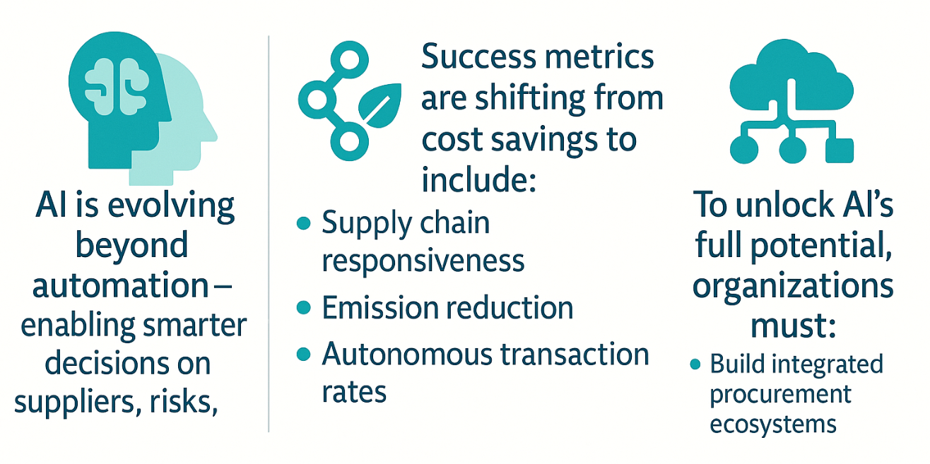
Beyond the Price Tag: Redefining Value for a Better Tomorrow

Slide 7
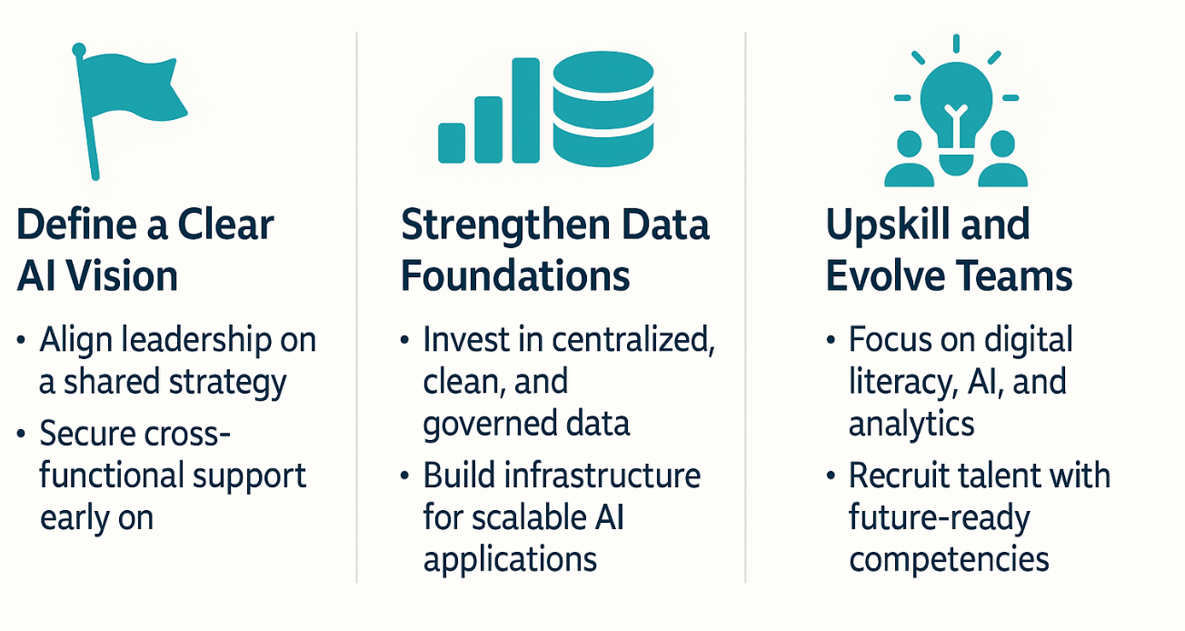
Laying the Tracks for AI Transformation

Slide 8
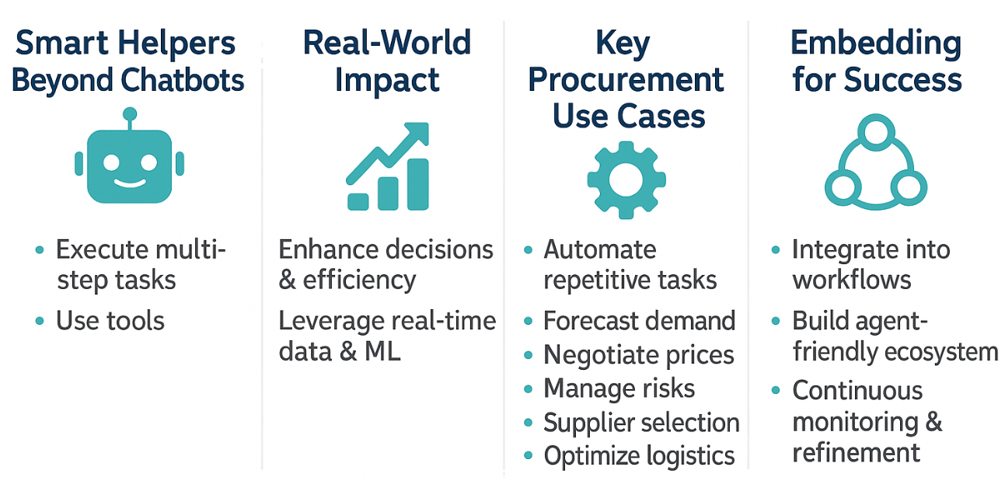
AI Agents at Work: The New Workforce in Procurement

Slide 9
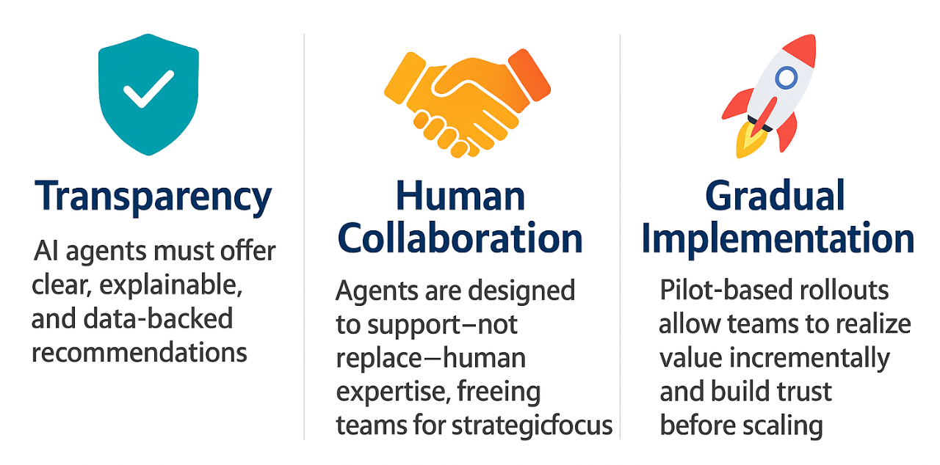
Built for Humans: AI That Works With You, Not Instead of You

Slide 10
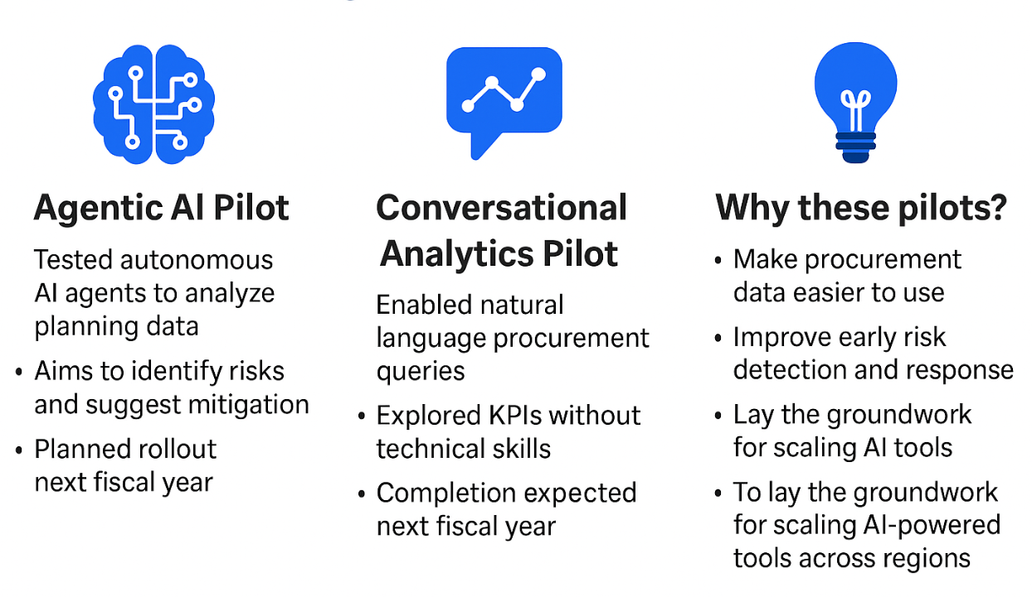
Pioneering Next-Gen Procurement

Slide 11
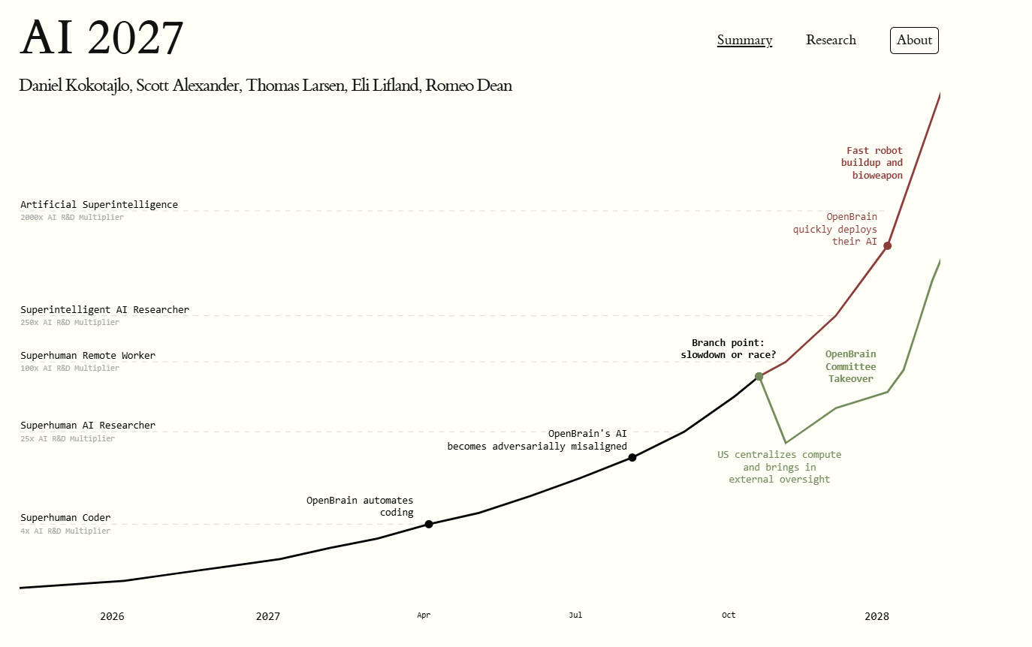
Ex-OpenAI Daniel Kokotajlo’s ‘AI 2027 predicts AGI by 2029, where AI is driving progress at warp speed

